Slide 1
Azure API Apps

Slide 2


App Service
Web Apps
Mobile Apps
Web apps that scale with your business
Build Mobile apps for any device
LOGIC Apps
Api Apps
Automate business process across SaaS and on-premises
Easily build and consume APIs in the cloud

Slide 3
Agenda
Challenges authoring and consuming APIs
API Apps overview & architecture
Authentication
Languages, tools, and SDKs
On-Premises
SaaS Connectors
Supporting Logic Apps

Slide 4
Challenges Authoring APIs
Manual plumbing: Logging, auth/SSO, secret store, config, updating, versioning
Difficult to integrate to on-premises and SaaS investments
No governance or monitoring of API performance without separate APIM product
Monolithic designs complicating versioning, agility, and scale
Notes:
All from a Devs pov:
A lot of mundane stuff
Difficulty in authoring data apps that are not part the cloud
No easy way to monitor the APIs

Slide 5
Challenges Consuming APIs
Difficult for professional developers; impossible for business users
Inconsistent metadata and authentication story
Lack of organizationally-scoped galleries
Inconsistent (or lack) of API documentation
Notes:
When it comes to how we define the metadata, and how we describe our metadata and handle the authentication
Always a lack of good API documentation

Slide 6
Azure API Apps provide a rich platform and ecosystem for building, consuming, and distributing APIs in the cloud and on-premises.
Notes:
What API Apps aspires to be this platform that will in building, consuming and distributing them in the cloud and on-prem

Slide 7
Why Azure API Apps?
Benefits of App Services
Automatic OS patching
Enterprise grade security
High availability
Support for many platforms & languages
Auto scaling and load balancing
WebJobs for background processing
Easy deployment, including continuous delivery
Access on-premises data
Additional Benefits
Bring your API as-is
Simple access control
Connectivity to SaaS platforms
Swagger metadata
Logic App integration
Visual Studio tooling and support
Public and private marketplaces
Automatic dependency deployment
Automatic updates
Notes:
Left side means that it already gets the underlying benefits of being a Web App or an App Service
Right side is the additional stuff for Azure API Apps for both devs and consumers
- We are not asking you to change your API offering – Python, Go, Node, Java, .NET, etc..
Define your Apps via Swagger – very strongly integrated with Azure API Apps
Private Marketplace coming soooon.
Auto dependency deployment – Just like nuget, you can describe a dependency in Azure API Apps – for eg if you are using your custom API app you can describe that dependency and when it gets deployed you will get that automatically activated for you, and your API will end up using it!

Slide 8
DEMO: Building your first API App
Notes:
Start at Portal:
Web + Mobile -> API App -> Create New (Takes about a minute)
Explain the App Service Plan – which is the underlying infrastructure/VM
Explain how there is a resource group – which is a logical group

Slide 9
Benefits of API Apps
Authoring APIs
Web Apps++
Simple access control
SSO
Metadata contracts
Microservice-style
Expose on-premises APIs
Easily package and publish
Consuming API Apps
Built-in authN support
SSO handled by server
Manual/automatic updates
SDK generation
API discovery
Public and organizational* galleries
Notes:
Microservices – single purpose API apps

Slide 10
API Apps Architecture Example
Backend is an API App with APIs from the gallery, as well as custom code. It is registered with and protected by AAD. Logins to downstream SaaS are facilitated by a consent server and token store, using a server flow.
Resource Group – App Service
API App Gateway
API Apps from Gallery
Custom Code
On-premises
Salesforce Connector
Mobile App (Data Access)
Clients
Web
Mobile (iOS)
Flow
Azure AD
Office 365 Connector
Direct deployed
3rd party SaaS
Logic Apps
Twilio Connector
Logic App Definitions
Azure AD
Logic App (also from gallery)
Consent Server
Facilitates SaaS login and token refresh
Token Store
other Azure services…

Slide 11
API Apps Architecture Example
Backend is an API App with APIs from the gallery, as well as custom code. It is registered with and protected by AAD. Logins to downstream SaaS are facilitated by a consent server and token store, using a server flow.
API App Gateway
Resource Group – App Service
API App Gateway
Runtime
Name resolution
Isolated storage
Shared config
API Apps from Gallery
Custom Code
On-premises
Salesforce Connector
Mobile App (Data Access)
Clients
Web
Mobile (iOS)
Flow
Azure AD
Proxy
API logging
API access level
Transforming API definition
Office 365 Connector
Direct deployed
3rd party SaaS
Identity Broker
AAD & social login
Secure token store
Consent server for SSO
Logic Apps
Mobile Services
Logic App Definitions
Azure AD
Logic App (also from gallery)
Token Store
Isolated storage
Consent Server
Facilitates SaaS login and token refresh
Shared config
other Azure services…
Secure token store

Slide 12
Authentication
Access levels
Public (anonymous): Anyone can call the API app from outside the resource group without being logged in.
Public (authenticated): Only authenticated users are allowed to call the API app from outside the resource group.
Internal: Only other API apps in the same resource group are allowed to call the API app.
Public Authenticated
Azure AD
Microsoft Account
Social IdPs: Facebook, Google, Twitter

Slide 13
Languages, tools, and SDKs
Languages
Anything supported by Azure App Services
.NET, Java, PHP, Python, Node, … and yes, even Go!
Tooling
Visual Studio: templates, publishing, debugging
X-platform Command Line tool (coming soon!)
SDKs
NuGet package for .NET; more coming!
Any HttpClient
Client code generation for C#, Java, and JavaScript
Drag/drop experience in Logic Apps

Slide 14
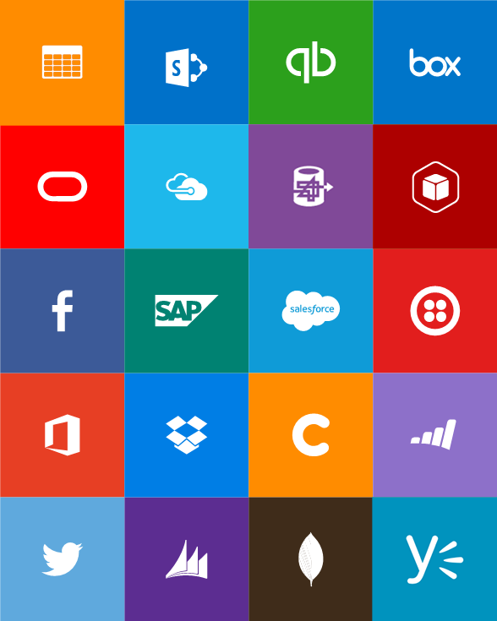
SaaS Connectors
Connectors
Box
Chatter
Delay
Dropbox
Azure HD Insight
Marketo
Azure Media Services
OneDrive
SharePoint
SQL Server
Office 365
Oracle
QuickBooks
SalesForce
Sugar CRM
SAP
Azure Service Bus
Azure Storage
Timer / Recurrence
Twilio
Twitter
IBM DB2
Informix
Websphere MQ
Azure Web Jobs
Yammer
Dynamics CRM
Dynamics AX
Hybrid Connectivity
Protocols
BizTalk Services
HTTP, HTTPS
File
Flat File
FTP, SFTP
POP3/IMAP
SMTP
SOAP + WCF
Batching / Debatching
Validate
Extract (XPath)
Transform (+Mapper)
Convert (XML-JSON)
Convert (XML-FF)
X12
EDIFACT
AS2
TPMOM
Rules Engine

Slide 15
Logic Apps
Visually create business process and workflows
Deliver integration capabilities in Web, Mobile, and API Apps
Integrate with your SaaS and enterprise applications
Automate EAI/B2B and business processes
Connect to on-premises data

Slide 16
Q&A

